Slide 1

A New Value Proposition for the AMA

Slide 2
Proposal
Implementing a value-driven measurement system for healthcare that results in expanding membership, improving relevancy, and increasing revenue potential for the AMA.
Value-Driven Healthcare System deliverables include:
Providing a unified vision for delivering sustainable value for patients, practitioners, and provider.
Driving innovation & collaboration in a cohesive manner.
Aligning continuous improvement (quality and efficiency) with patient-driven value across the continuum of care.

Slide 3



The Vision
Value
Quality
Practitioner-Driven
Results
Provider-Driven
Patient-Driven
“Health care organizations are increasingly concerned with looking beyond financial performance measures, while focusing on how to deliver higher quality care “
- Love, Dianne, Revere, Lee, and Black, Ken. (2008), Journal of Health Care Finance

Slide 4
Current Challenges
AMA Challenges:
Eroding member base.
Aging membership.
Decline in revenues from membership.
Not perceived as an innovation leader.
Healthcare Challenges:
Continuum of care is not measured from a patient (customer) perspective.
Healthcare is fractionalized and becoming more distributed.
The government is trying to lead healthcare reform.
There is no clear leadership to drive reform, innovation, and unification across the healthcare continuum.
“There should be no presumption that good quality is more costly. In health care…better providers are usually more efficient.”
- Redefining Health Care

Slide 5
AMA’s Opportunities
Drive reform, innovation, and unification across the healthcare continuum.
Provide healthcare stakeholders with the following answers:
Practitioners are worried about quality, timeliness, and effort of care
Patients are worried about quality of care, loss of control, and cost
Providers are worried about loss of control and revenue
Unify leadership across the 3Ps to provide guidance and direction for change (much of which will be disruptive).
Encourage collaboration and cooperation to solve the healthcare needs in the US.
Create a “system” of healthcare guided by patient-driven value metrics.

Slide 6
AMA at the forefront of Healthcare
Defining & delivering the prescription for healthcare reform should come from within healthcare (not the government).
Creating a vision for a new healthcare system by forming a collaborative model with healthcare advocacy organizations, institutions, providers and practitioners.
Providing the practitioners with a consistent set of benchmarks for measuring the value they deliver to patients.
Driving open innovation among providers to create a more efficient process for guiding and creating value.
Working collaboratively with the government to guide more efficient and effective funding that drives healthcare reform.

Slide 7
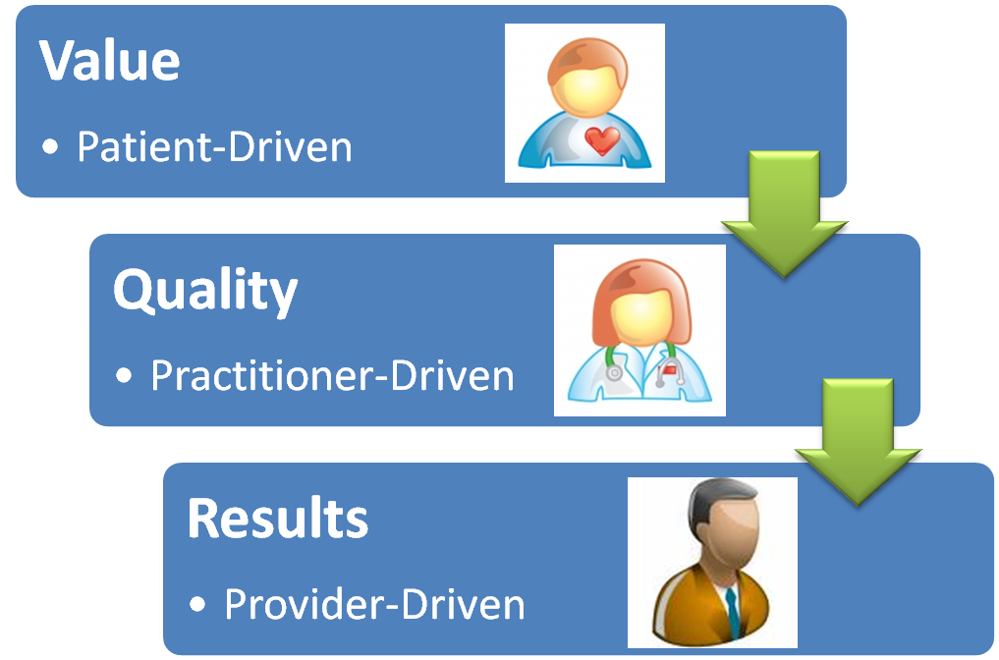
An Expanded Membership Model
Providing Patients with a way to measure the value they should be receiving for healthcare throughout the continuum
Guiding Practitioners to measure and optimize the value they deliver to Patients
Guiding the Providers to deliver value to Patients & Practitioners
AMA

Slide 8
Needs of the Patients
To have affordable healthcare.
To have attainable healthcare.
To have more accessible healthcare.
To have consistent levels of quality (results).
To receive a total healthcare experience:
Ensure their functional outcomes are met.
Ensure their emotional outcomes are met.
Ensure their outcomes are met across the continuum of care (beyond the hospital, into clinics, and into the home).
“We continue to pay for lots of medical procedures that don't add to health value and in fact just add costs to the system..”
- Kathleen Sebelius

Slide 9
Needs of the Practitioners
To improve diagnostic capabilities in a cost-effective manner.
To improve clinical processes.
To provide consistent levels of quality.
To move beyond service and deliver a positive experience.
To create benchmarks to reliably measure value for their patients, for themselves as individual practitioners , and for their practices.

Slide 10
Needs of the Providers
To be aligned and focused on a consistent set of outcomes with pharmaceutical and device manufacturers, insurers, and healthcare suppliers.
To increase collaboration NOT competition.
To have value-driven benchmarks across the healthcare network.
To move towards a shared revenue model where everyone can still win, but not at the expense of others (esp. the patients & the public).

Slide 11
Enabling Value for Healthcare
Value-Driven Healthcare Platform
Technology
Ideas
Resources
Innovation
Value Measurement
New Concepts
New Products & Services
New Value Delivery
Outcomes
Compliance
Quality & Efficiency
Value-Driven metrics are used to drive innovation & direct Quality & Efficiency

Slide 12
Deliverables for an Expanded Membership Model
A program focused on mapping the Jobs & Outcomes across the healthcare domain.
A portfolio of unmet needs (opportunities) for improving value delivery to patients and practitioners.
A prioritization model to direct resources in an efficient manner.
An open innovation framework using the opportunities to generate ideas that can address the most important (prioritized) unmet needs.
A shared revenue model as part of a collaborative to address unmet needs.

Slide 13
Thank You
Prepared by
Jeffrey Wallk (Managing Partner)
Helene Sigman (Strategic Partner)

